Slide 1

7th Grade Math
Unit 9, Lesson 3 Subtracting Linear Expressions with Rational Coefficients Volume 2, pg. 52

Slide 2


Benchmark
MA.7.AR.1.1
Apply properties of operations to add and subtract linear expressions with rational coefficients.
volume 2, pg. 52

Slide 3
Integrated Mathematical Thinking and Reasoning Standards
MA.K12.MTR.2.1 Demonstrate understanding by representing problems in multiple ways.
MA.K12.MTR.3.1 Complete tasks with mathematical fluency.
volume 2, pg. 52

Slide 4

Learning Target
I can subtract linear expressions with rational coefficients.
volume 2, pg. 52

Slide 5

Warm-Up
volume 2, pg. 52

Slide 6
9.3.1 Warm-Up: Bell Work
Combine like terms.
$\left(3y+4.6\right)+\left(−5y−3.25\right)$ | $\left(6\frac{3}{4}x−7\right)+\left(−\frac{5}{2}x+7\right)$
volume 2, pg. 52

Slide 7

Exploration
volume 2, pg. 53

Slide 8

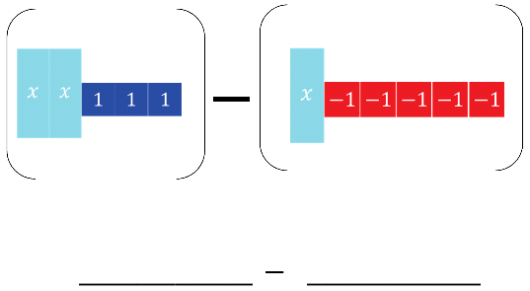
9.3.2 Exploration: Subtracting Expressions with Algebra Tiles
Algebra tile representations are given below. Use the algebra tiles to find the difference.
On the lines, write the algebraic expression for each representation.
Rearrange the tiles to show subtraction of like tiles together. Draw the representation.
volume 2, pg. 53

Slide 9
If necessary, create any zero pairs needed for subtraction.
Find the difference by subtracting (taking away) like tiles. Write the algebraic representation of the difference.
volume 2, pg. 53

Slide 10

Collaboration
volume 2, pg. 53

Slide 11


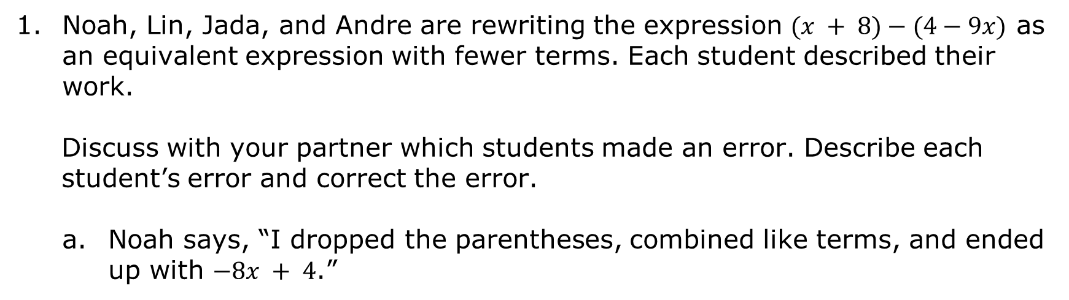
9.3.3 Collaboration: Subtracting Expressions
Noah, Lin, Jada, and Andre are rewriting the expression $(x + 8)−(4−9x)$ as an equivalent expression with fewer terms. Each student described their work.
Discuss with your partner which students made an error. Describe each student’s error and correct the error.
Noah says, “I dropped the parentheses, combined like terms, and ended up with $−8x + 4$.”
$$\left(x + 8\right)−(4−9x)$$
$$x + 8− 4−9x \\ −8x + 4$$
volume 2, pg. 53

Slide 12
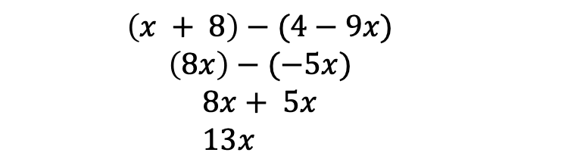
Lin says, “I simplified inside the parentheses and ended up with $13x$.”
$$\left(x + 8\right)−(4−9x)$$
$$\left(8x\right)−(−5x)$$
$$8x+ 5x \\ 13x$$
volume 2, pg. 53

Slide 13
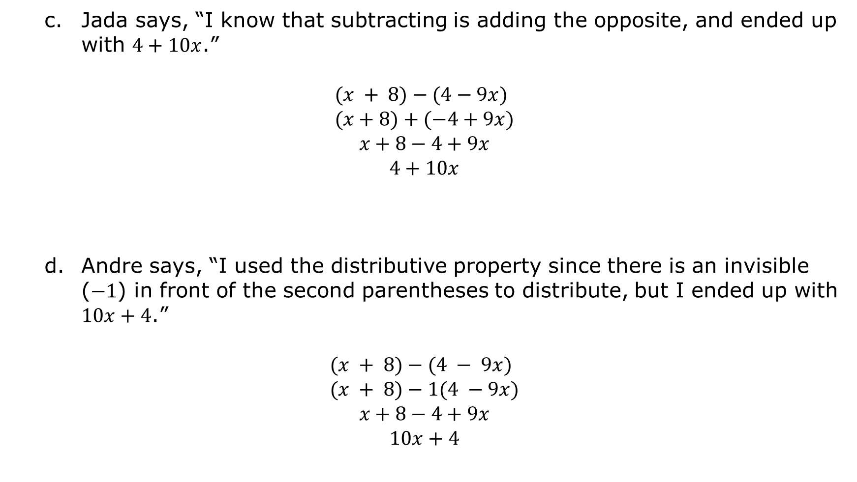
Jada says, “I know that subtracting is adding the opposite, and ended up with $4+10x$.”
$$(x + 8)−(4−9x) \\ (x+8)+(−4+9x)$$
$$x+8−4+9x$$
$$4+10x$$
Andre says, “I used the distributive property since there is an invisible ($−1$) in front of the second parentheses to distribute, but I ended up with $10x+4$.”
$$(x + 8)−(4 − 9x) \\ (x + 8)−1(4 −9x)$$
$$x+8−4+9x$$
$$10x+4$$
volume 2, pg. 54

Slide 14
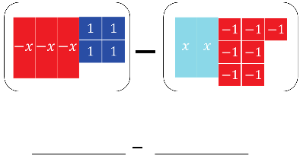
When subtracting expressions, use the distributive property to add the opposite. With the algebra tile representations below, model finding the difference by adding the opposite.
On the lines, write the algebraic expression for each representation.
Rewrite subtracting to adding the opposite by changing (or flipping) the sign of the 2nd expression. Draw the representation.
Combine any zero pairs to find the sum. Write the sum.
volume 2, pg. 54

Slide 15

Guided Instruction
volume 2, pg. 55

Slide 16
9.3.4 Guided Instruction: Subtracting Linear Expressions
To subtract linear expressions,
add the ______________, or additive inverse of each term in the expression.
OR
distribute a __________ to each term in the expression.
volume 2, pg. 55

Slide 17
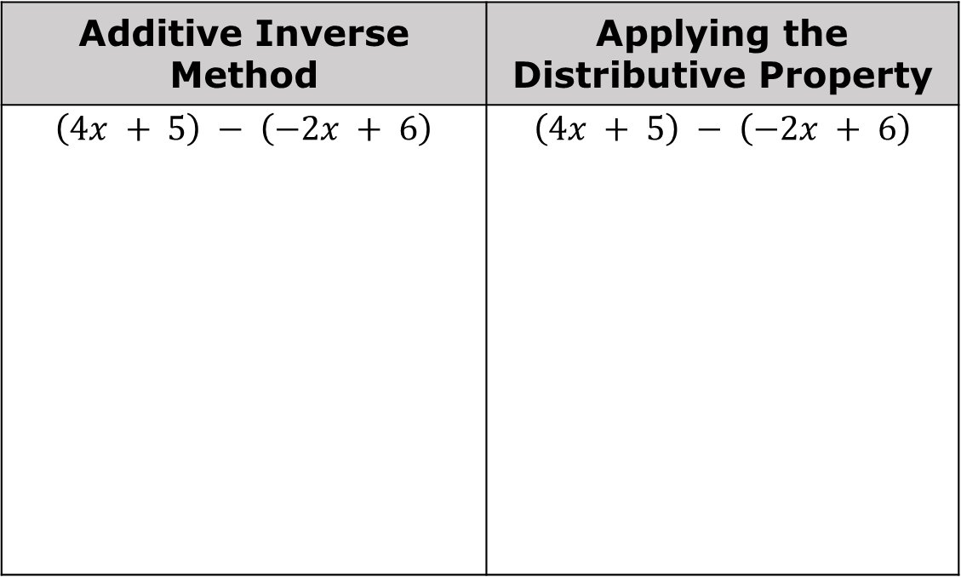
Complete the table to show both methods.
Additive Inverse Method | Applying the Distributive Property
$$\left(4x + 5\right) − \left(−2x + 6\right)$$ | $$\left(4x + 5\right) − \left(−2x + 6\right)$$
volume 2, pg. 55

Slide 18
When adding and subtracting, parentheses are used to group expressions. Why is the use of parentheses especially important when subtracting?
volume 2, pg. 55

Slide 19

Guided Practice
volume 2, pg. 55

Slide 20

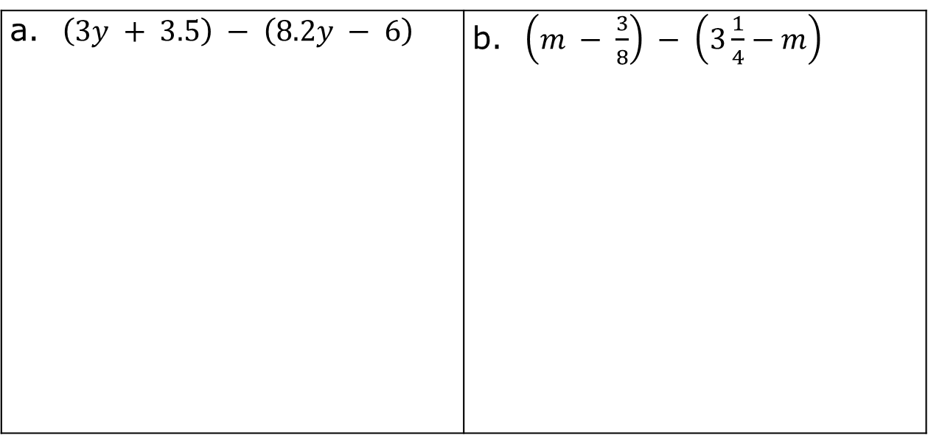
9.3.5 Guided Practice: Subtracting Linear Expressions with Rational Coefficients
Find the difference of each expression.
$\left(3y + 3.5\right) − \left(8.2y − 6\right)$ | $\left(m − \frac{3}{8}\right) − \left(3\frac{1}{4}−m\right)$
volume 2, pg. 55

Slide 21
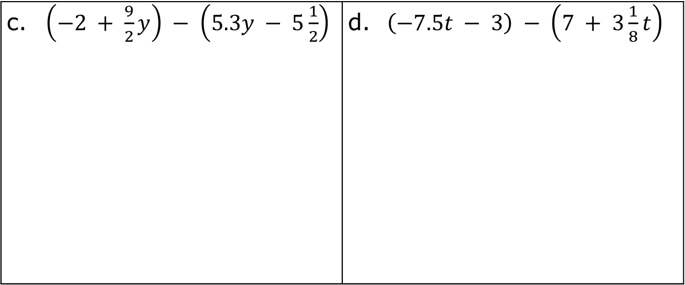
$\left(−2 + \frac{9}{2}y\right) − \left(5.3y − 5\frac{1}{2}\right)$ | $\left(−7.5t − 3\right) − \left(7 + 3\frac{1}{8}t\right)$
volume 2, pg. 55

Slide 22
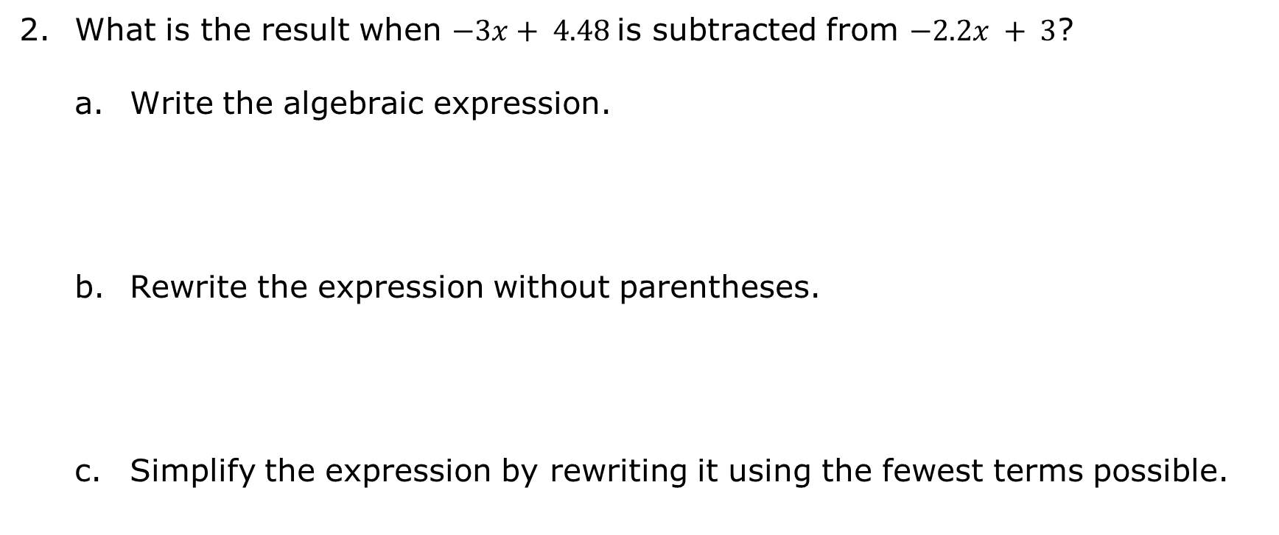
What is the result when $−3x+ 4.48$is subtracted from $−2.2x + 3$?
Write the algebraic expression.
Rewrite the expression without parentheses.
Simplify the expression by rewriting it using the fewest terms possible.
volume 2, pg. 56

Slide 23

Your Turn
volume 2, pg. 56

Slide 24
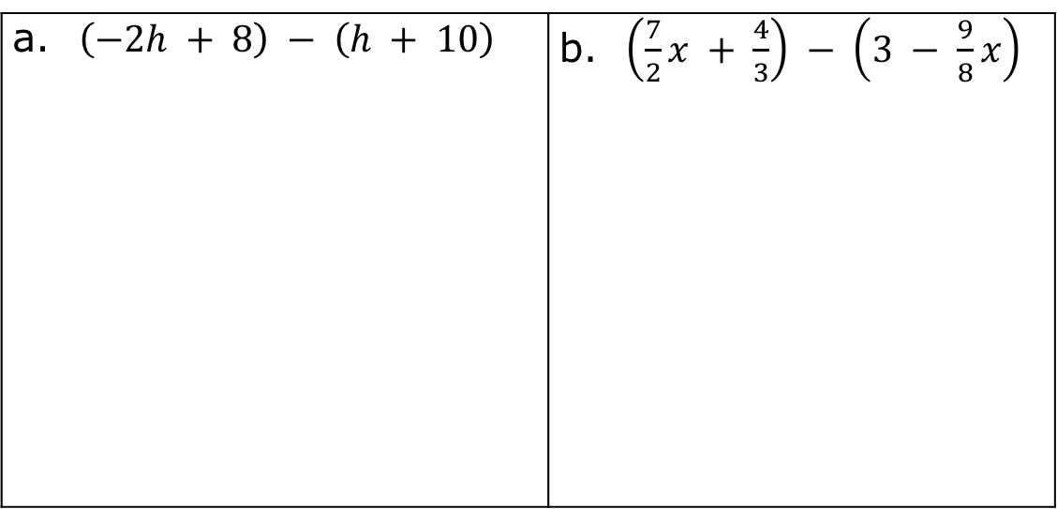
9.3.6 Your Turn!
Find the difference of each expression in simplest form.
$\left(−2h + 8\right) − \left(h + 10\right)$ | $\left(\frac{7}{2}x + \frac{4}{3}\right) − \left(3 − \frac{9}{8}x\right)$
volume 2, pg. 56

Slide 25
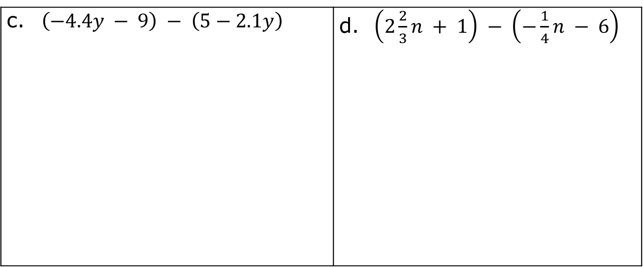
$\left(−4.4y − 9\right) − \left(5−2.1y\right)$ | $\left(2\frac{2}{3}n + 1\right) − \left(−\frac{1}{4}n − 6\right)$
What is the result when $\frac{5}{8}x+\frac{4}{3}$ is subtracted from $\frac{5}{4} x−\frac{31}{6}$?
volume 2, pg. 56

Slide 26

Wrap-Up
volume 2, pg. 57

Slide 27
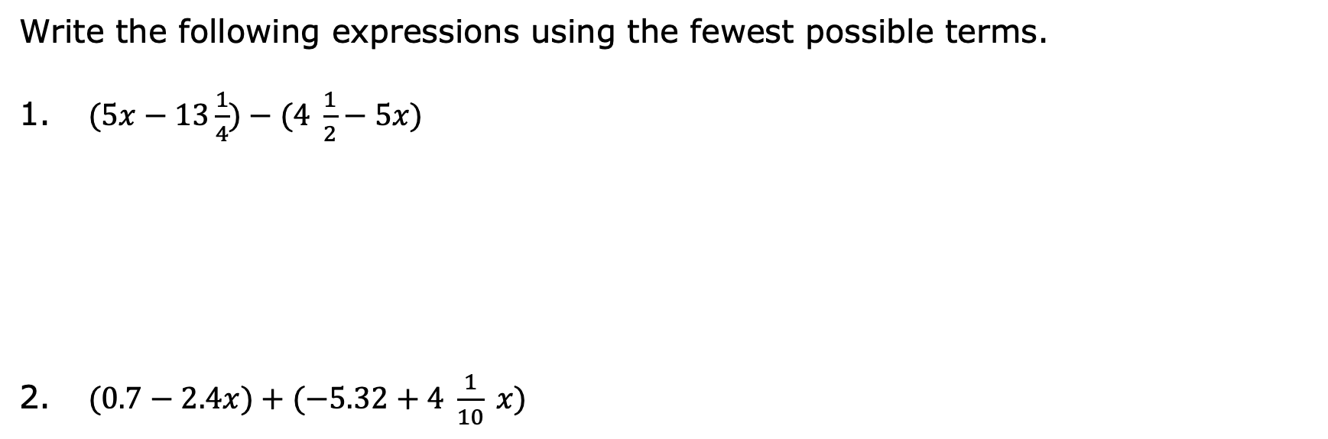
9.3.7 Wrap-Up: Ticket Out the Door
Write the following expressions using the fewest possible terms.
$(5x−13\frac{1}{4})−(4 \frac{1}{2}−5x)$
$(0.7−2.4x)+(−5.32+4 \frac{1}{10} x)$
volume 2, pg. 57

